Slide 1

KidSafe
Android Parental Control App

Slide 2
According to the independent, one in four children under the age of six has a smart phone. Despite parents insisting that 11 is the "ideal" age for children to have a phone, a poll found 25 per cent of children aged six and under already have their own mobile and nearly half of these are spending an average of 23 hours a week on smart phones and other gadgets - twice as much time as they spend conversing with their parents, polling suggests.

Slide 3
KidSafe is an android parental control app which when installed on the child’s device and linked with his parent’s, will provide the parents remote access to that device, giving them the ability to control, block or manage certain features that can ensure your child’s safety and digital well being.

Slide 4
How?

Slide 5
Features
Lock/Unlock the child’s device
Screen time control
App blocking
Location tracking
Geo-fencing
View the child’s activity (SMS and Phone calls)
View the child’s contacts as well as calling or messaging these contacts

Slide 6
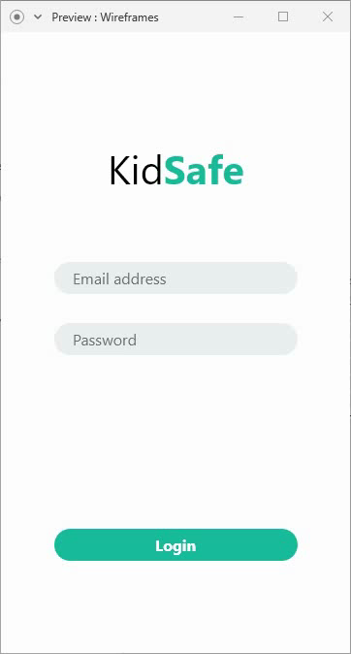
Wire-Framing

Slide 7

Locking and unlocking the child's device
KidSafe allows the parents to lock and unlock their children’s smart phones or tablets remotely.

Slide 8
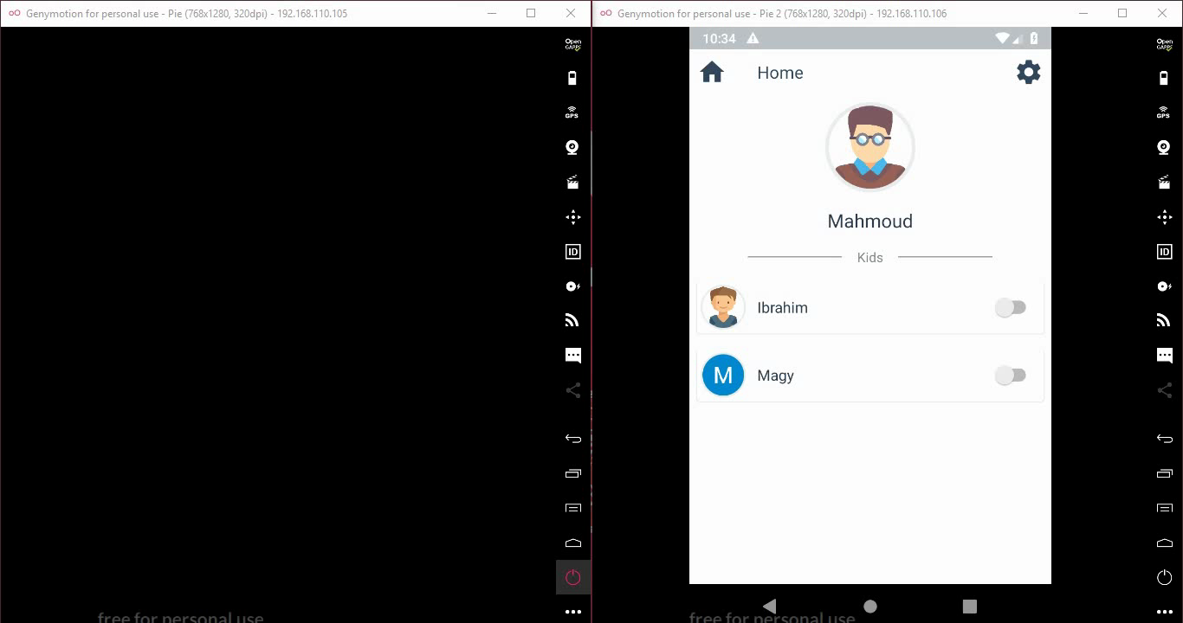

Slide 9

Screen time control
KidSafe allows the parents to define a daily usage time limit, if the child exceeds it, the device locks automatically until the next day when the timers reset.

Slide 10
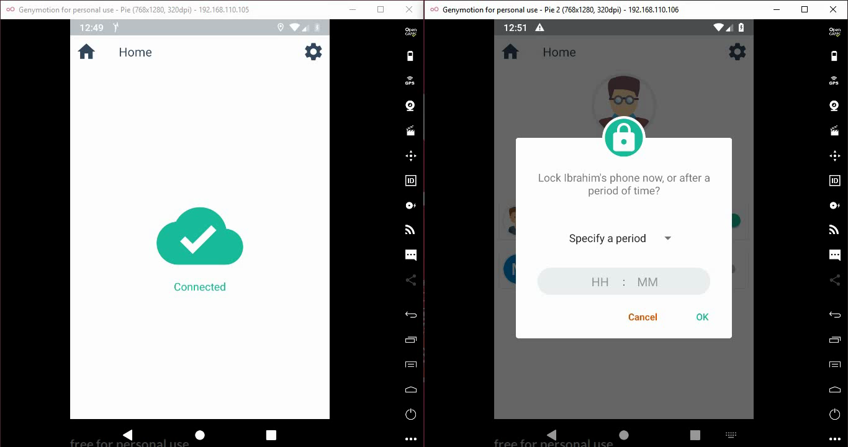

Slide 11
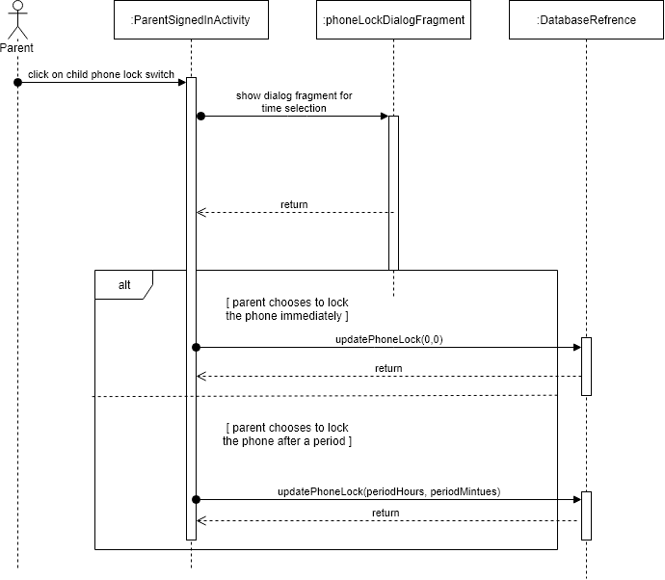

Slide 12

App blocking
KidSafe allows the parents to block the child's addictive apps by just a click of a button.

Slide 13
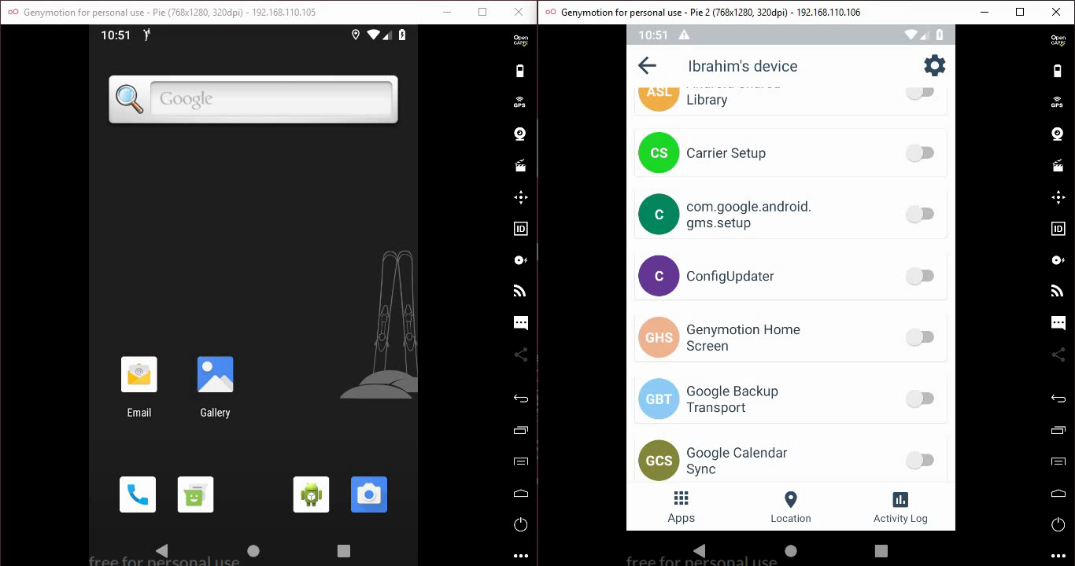

Slide 14
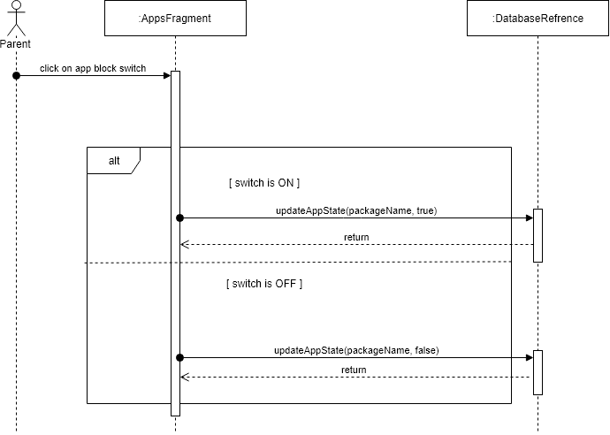

Slide 15

Location tracking
KidSafe allows the parents to view their child’s real time location.

Slide 16
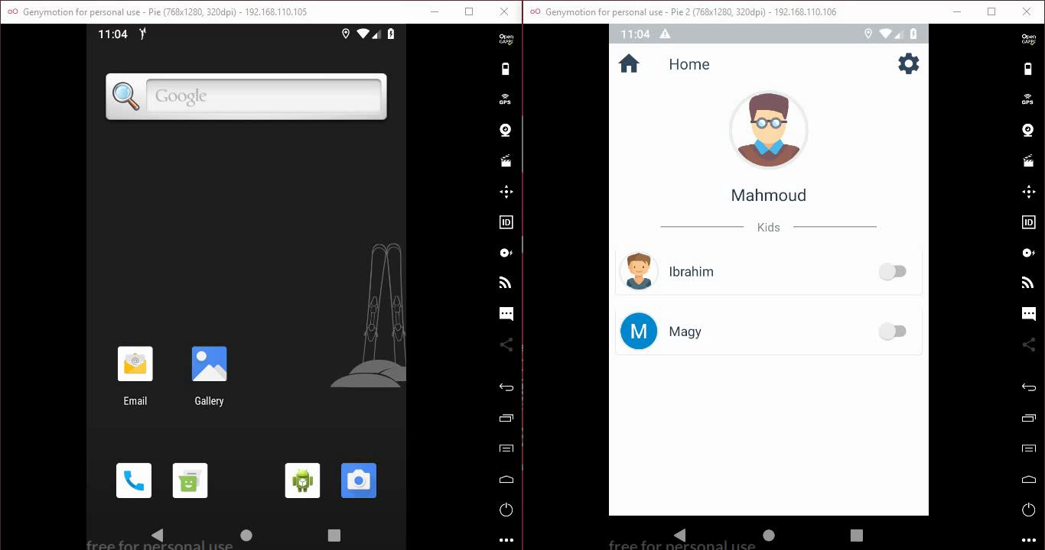

Slide 17

Geo-Fencing
KidSafe allows the parents to set Geo-fences around their children.
is very simple, image if we simply draw a a circle with a center of either you or him and a diameter in meters as you wish. When Ibrahim leaves this circle, the parent “Mahmoud” will be notified and alerted.

Slide 18
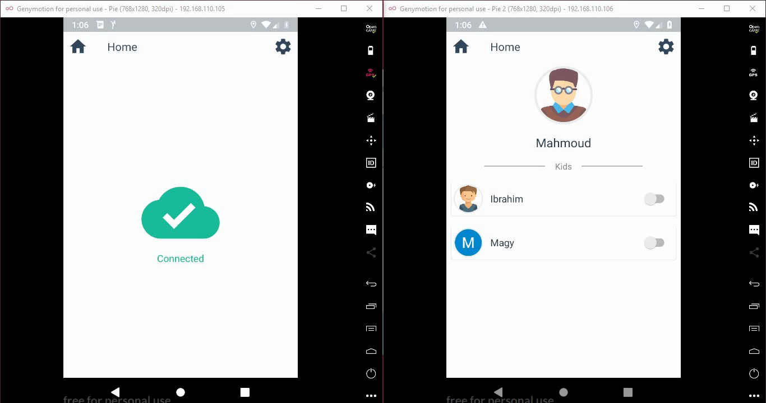

Slide 19
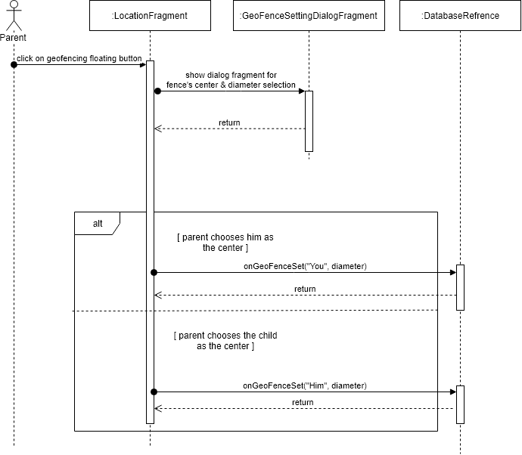

Slide 20


View the child's activity
KidSafe allows the parents to view their children's SMS & call logs.

Slide 21


Slide 22
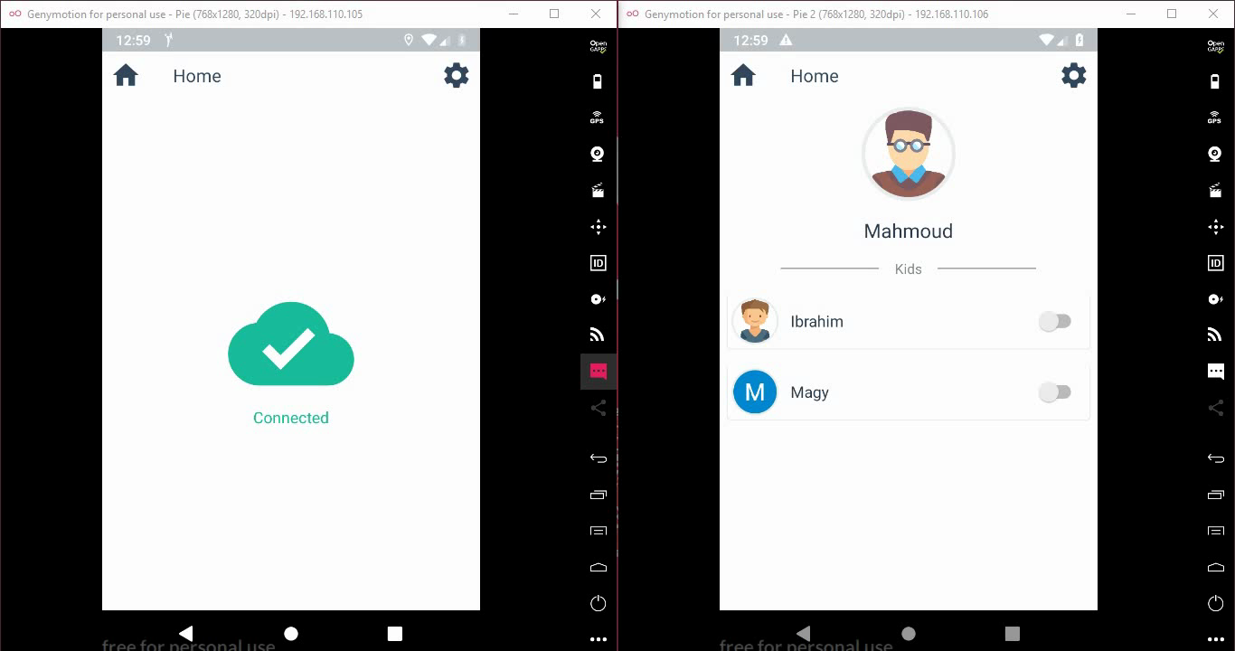

Slide 23
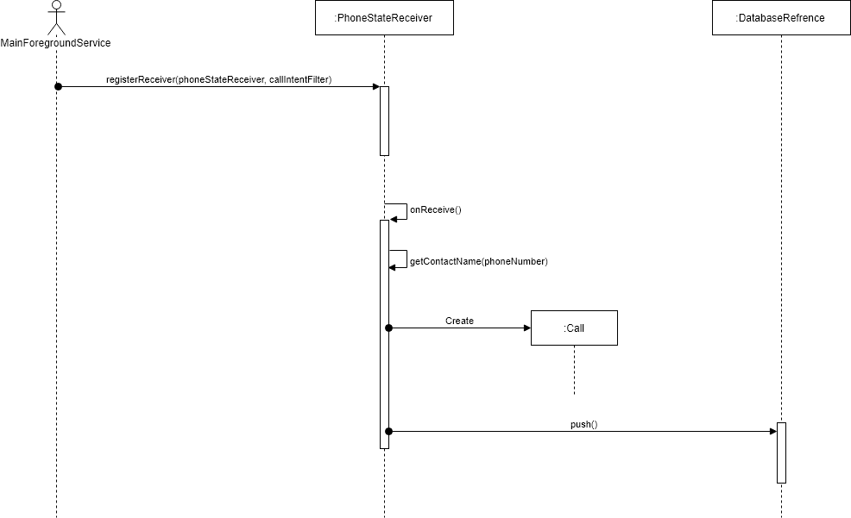

Slide 24


Slide 25
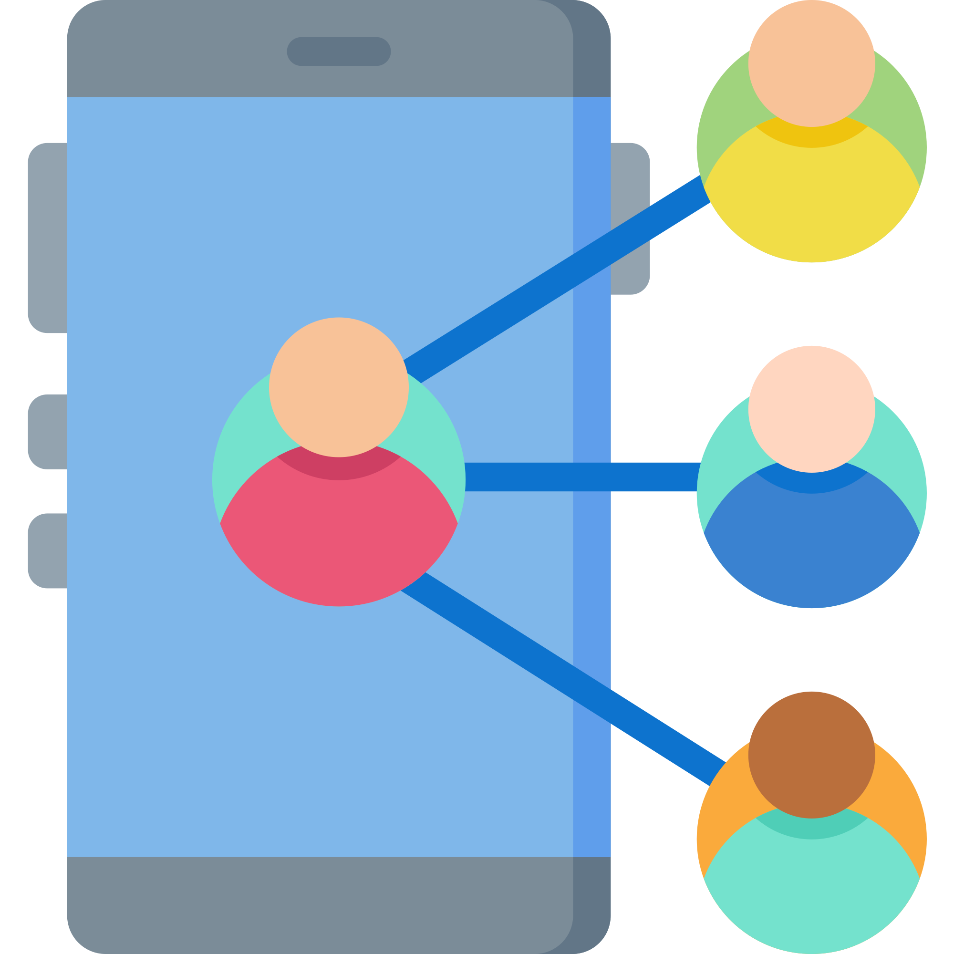
View, call or message the child's contacts
KidSafe allows the parents to view, call or message their children's contacts.

Slide 26


Slide 27
Privacy Violation

Slide 28
Thank You

